Slide 1
CCC 402 –Genetic Engineering-a journey of Life
Genesis of Life
DNA structure
DNA Function,
DNA Replication,
Central Dogma Transcription,
Codons
Translation,
Gene cloning, - 2
PCR,
Mutations
Protein structure, -2
Protein expression, -2
Protein Purification, -2
Importance in Plant and Animal Biotechnology
Quiz 1 Aug 22
Quiz 2 Sep 5
Doubt Clearing
LIST OF LECTURES Marks Distribution
Quizes (10 marks each-MCQ)
Final – 40 Questions (~ 15-20 questions short answers – 2 line answers, 2 marks each)
(20 Questions MCQ – 2 marks each)
Slides will be uploaded at the end of every week
Reference book is Gene Manipulation Old and Primrose
(Students are welcome to discuss anything between 1-2 PM, any day)

Slide 2
DNA Functions
Stores genetic information to build and maintain a living organism
Copies itself

Slide 3
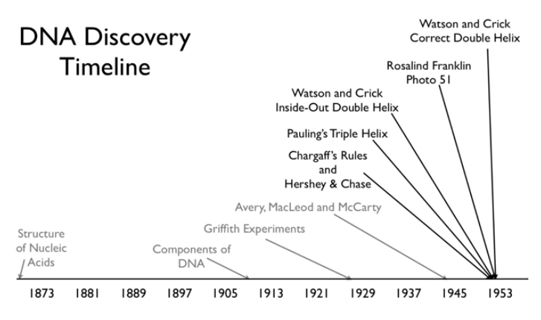

Slide 4
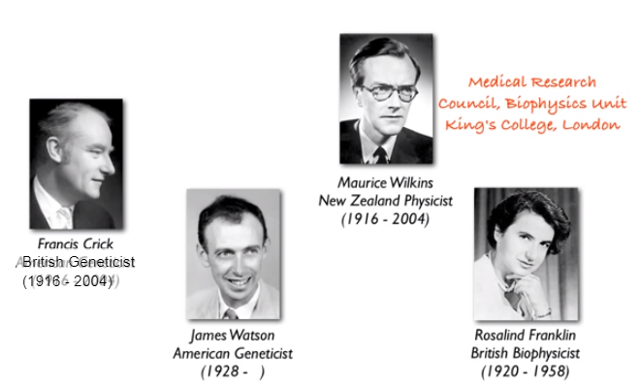

Slide 5
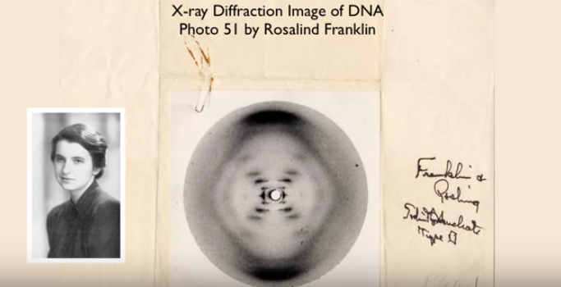

Slide 6
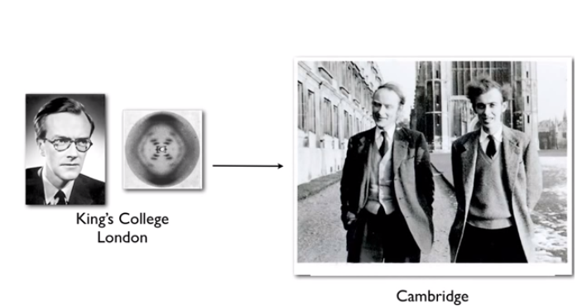

Slide 7
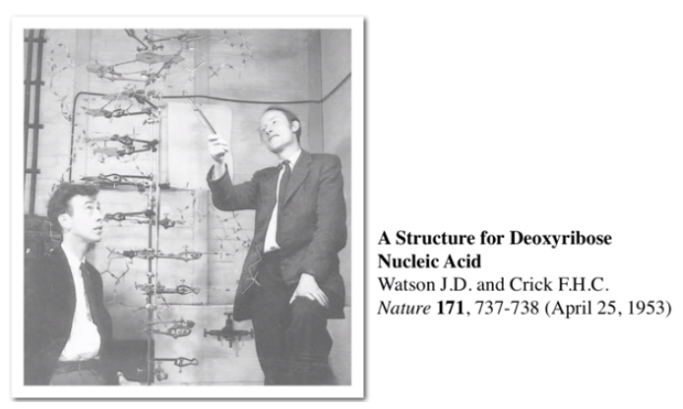

Slide 8
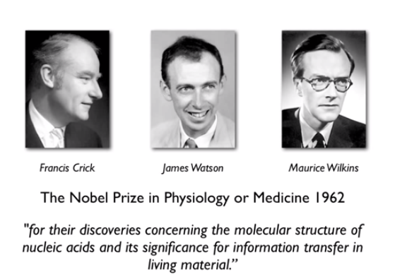

Slide 9
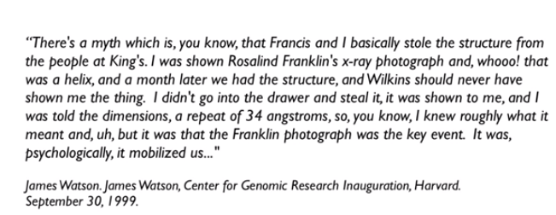

Slide 10
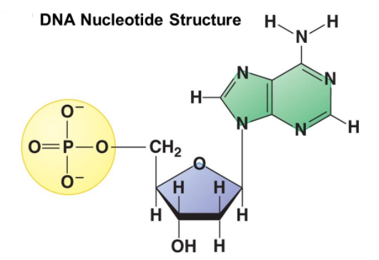

Slide 11
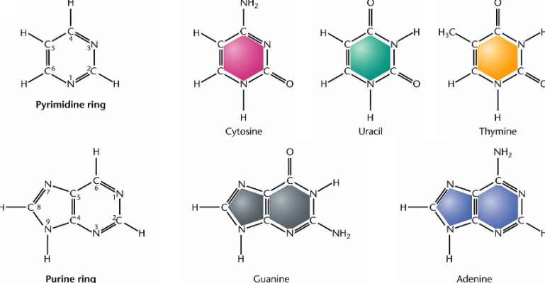

Slide 12
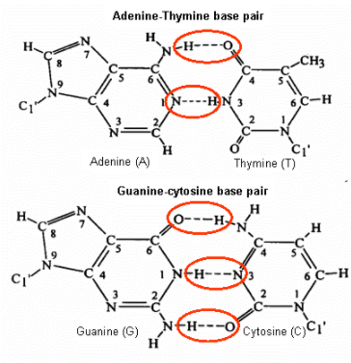
PAIRING BETWEEN NUCLEOTIDES

Slide 13

Determined the three-dimensional structure of DNA
One of the greatest discoveries in the history of science
Nobel prize in 1962

